Slide 1

Exploratory Data Analysis Project:
Video Games Trends 1980-2020

Slide 2

Used Technologies and Preparation for the Data Analysis
Python as the main programming language
Pandas for visualisation, various data manipulation operations such as importing data, selecting and cleaning the data
Matplotlib library for visualisation
Jupyter Notebook as IDE

Slide 3
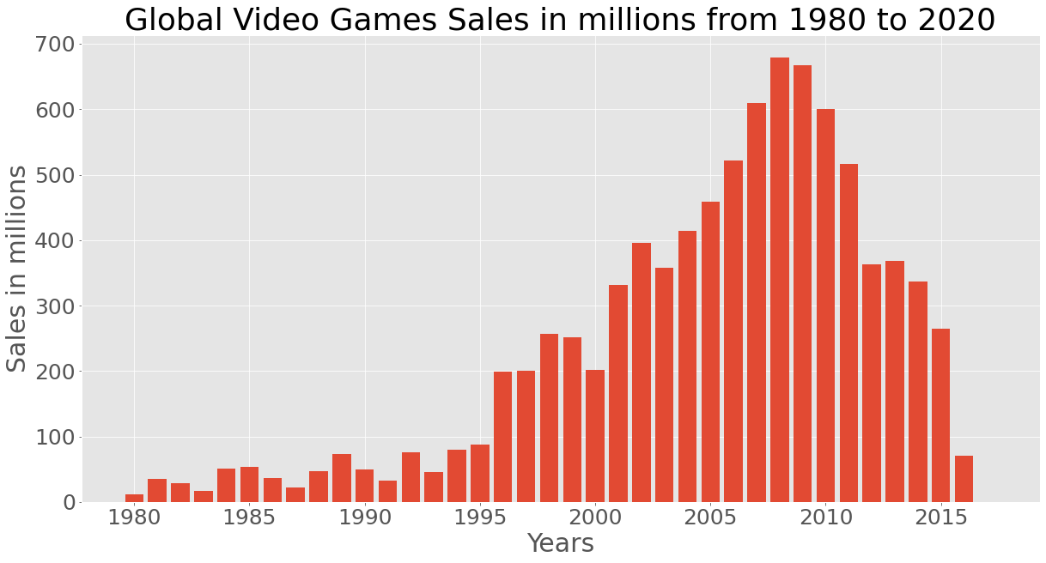

Results: the Most Sales by Year
As we can clearly see in the graph, 2008 was the most successful year in term of sales with a value of ~679 Million USD

Slide 4
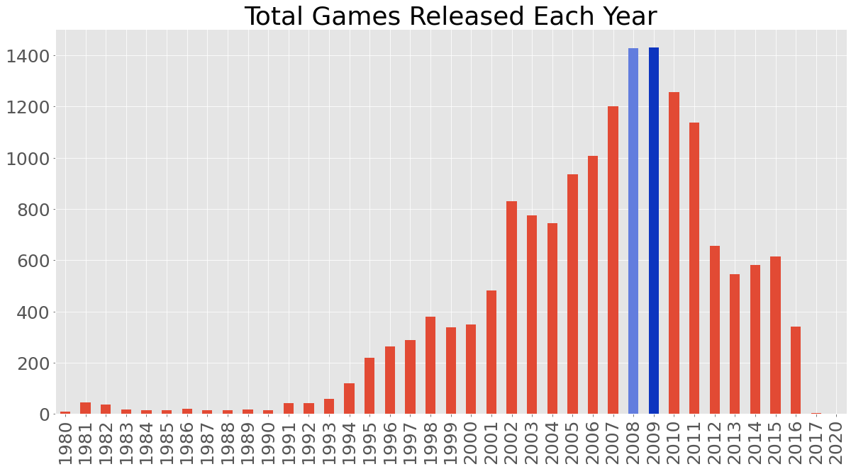


Results: When the Most Games Were Released
2009 and 2008 are the years when the most games were released. The difference between 2008 and 2009 only 3 games: 1428 vs 1431.

Slide 5
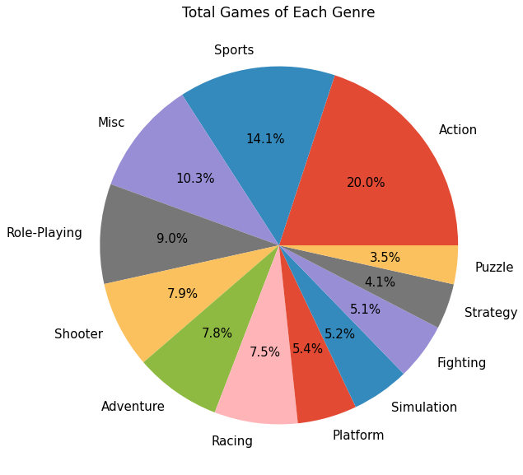

Results: the Most Popular Genres
Action is the most popular genre. The second place belongs to Sport and the third to Misc (Miscellaneous) games.

Slide 6
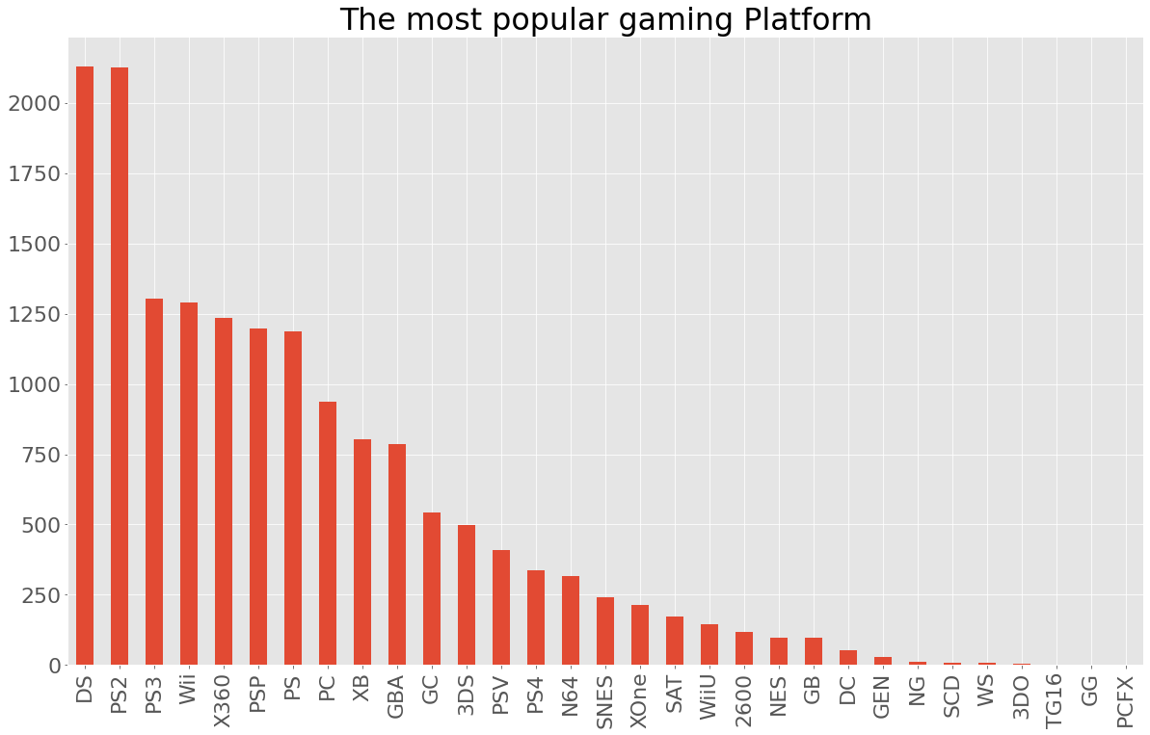

Results: the Most Popular Platform
The most popular platform for video games is DC from Nintendo. The second and the third places belong to PS2 and PS3

Slide 7
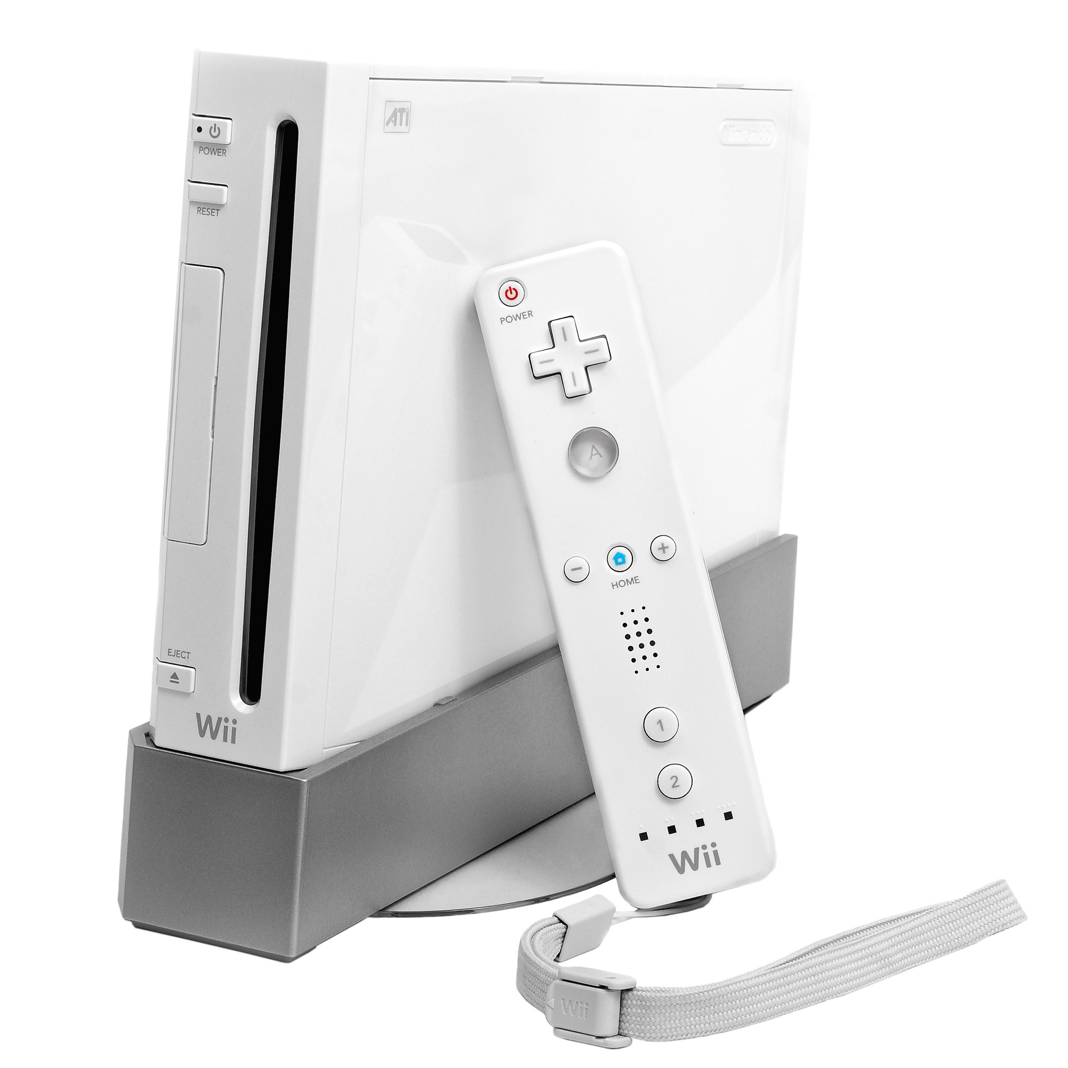
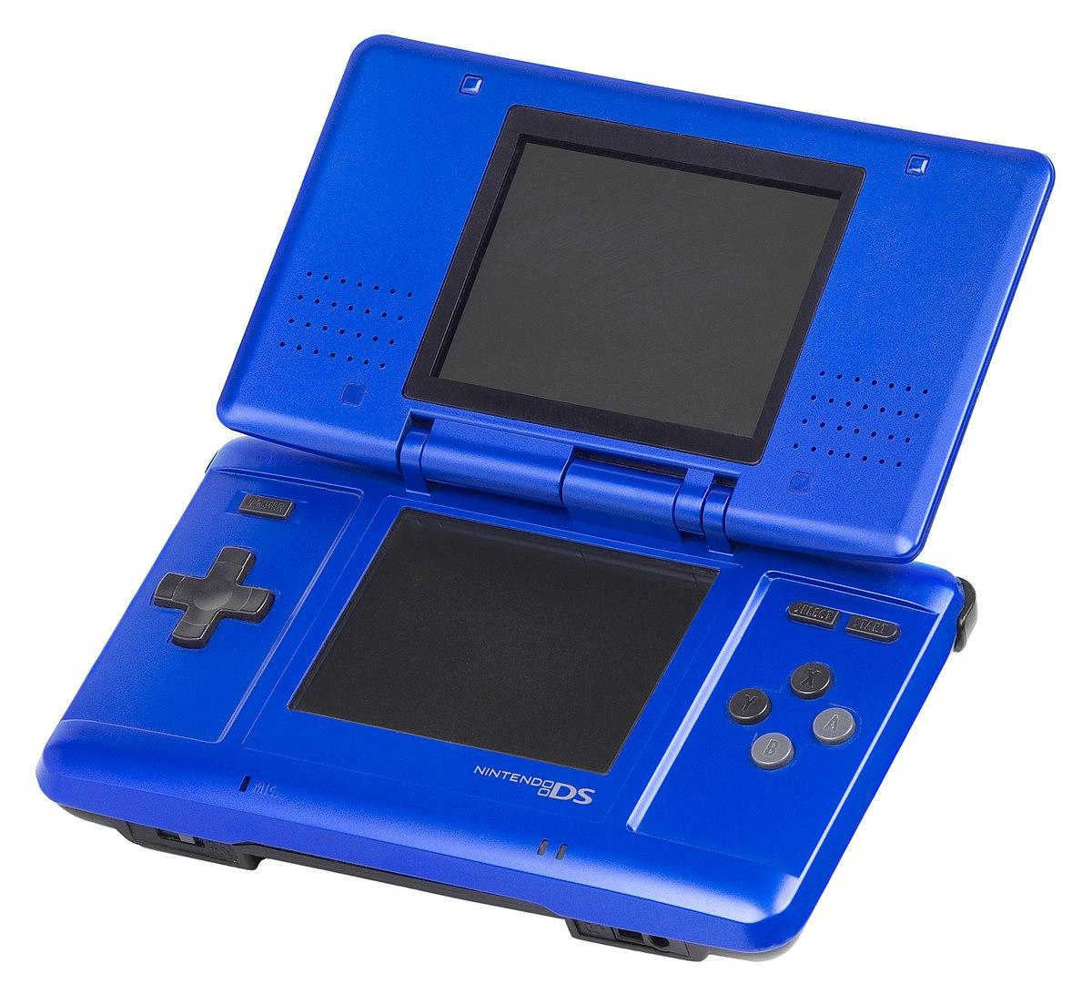
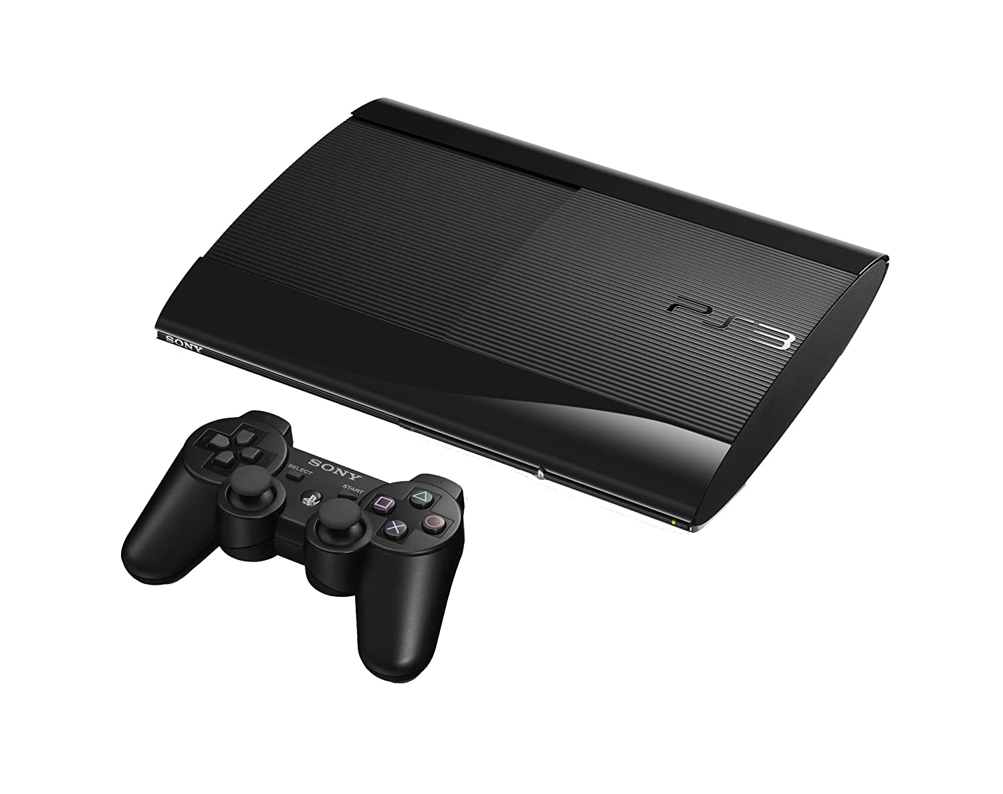
Time for Nostalgie
DC from Nintendo
PS 3
Wii from Nintendo

Slide 8
Thank you for the attention!

